Slide 1
Bayesian Regression Modeling in R Material from: Nathan T. James
2019-09-27
http://biostat.mc.vanderbilt.edu/wiki/pub/Main/StatisticalComputingSeries/bayes_reg_rstanarm.html#
Bayes theorem:
P(B|A) = P(A∩B)/ P(A) so P(A∩B) = P(A) P(B|A)
and P(A|B) = P(A∩B)/P(B) P(A∩B)= P(B) P(A|B)
So, P(B|A) = P(A|B) P(B)/ P(A)
and P(A|B) = P(B|A) P(A)/P(B)
Suppose a test for Corona is 99% sensitive and 99% specific.
Prevalence of Corona ~ .001
P(Corona|+) = P(+|Corona) P(Corona)/P(+)
but P(+) = P(+ ∩ Corona) + P(+ ∩ Not Corona)
=P(+|Corona)P(Corona) + P(+|Not Corona)P(Not Corona)
=0.99 x 0.001 + 0.01 x 0.999 = 0.01098
So P(Corona|+) = (.99)(.001)/0.01098 = 0.0902

Slide 2
P(A|B) = P(B|A) P(A)/P(B
Bayesian inference provides a principled method of combining prior information concerning parameters (such as regression coefficients) with observed outcome and covariate data based on Bayes Theorem.

Slide 3
Specifying the priors on the parameters of interest (in regression, β₀, β₁, . . ., β_{k} and σ²
An informative prior expresses specific, definite information about a variable. An example is a prior distribution for the temperature at noon tomorrow. A reasonable approach is to make the prior a normal distribution with expected value equal to today's noontime temperature, with variance equal to the day-to-day variance of atmospheric temperature, or a distribution of the temperature for that day of the year.
An uninformative prior expresses vague or general information about a variable. Uninformative priors can express "objective" information such as "the variable is positive" or "the variable is less than some limit". The simplest and oldest rule for determining a non-informative prior is the principle of indifference, which assigns equal probabilities to all possibilities (uniform distribution). In parameter estimation problems, the use of an uninformative prior typically yields results which are not too different from conventional statistical analysis, as the likelihood function often yields more information than the uninformative prior.
Prior Choice Recommendations (Andrew Gelman) 5 levels of priors
Flat prior (not usually recommended);
Super-vague but proper prior: normal(0, 1e6) (not usually recommended);
Weakly informative prior, very weak: normal(0, 10);
Generic weakly informative prior: normal(0, 1);
Specific informative prior: normal(0.4, 0.2) or whatever. Sometimes this can be expressed as a scaling followed by a generic prior: theta = 0.4 + 0.2*z; z ~ normal(0, 1);

Slide 5
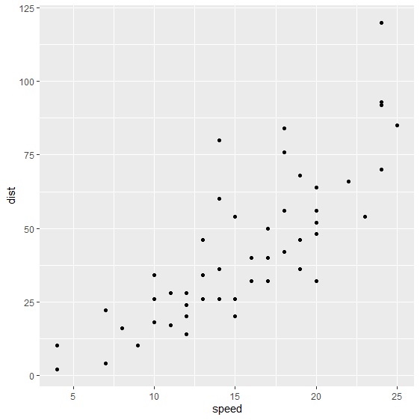
glm_post1 <- stan_glm(dist~speed, data=cars, family=gaussian)
Use the cars dataset which gives the speed of 50 cars along with the corresponding stopping distances.
glm_post1 <- stan_glm(dist~speed, data=cars, family=gaussian)

Slide 6
We can also extract these posterior samples to get an estimate of the mean and a 95% credible interval.

Slide 7
##
## Call:
## glm(formula = dist ~ speed, family = gaussian, data = cars)
##
## Deviance Residuals:
## Min 1Q Median 3Q Max
## -29.069 -9.525 -2.272 9.215 43.201
##
## Coefficients:
## Estimate Std. Error t value Pr(>|t|)
## (Intercept) -17.5791 6.7584 -2.601 0.0123 *
## speed 3.9324 0.4155 9.464 1.49e-12 ***
## ---
## Signif. codes: 0 '***' 0.001 '**' 0.01 '*' 0.05 '.' 0.1 ' ' 1
##
## (Dispersion parameter for gaussian family taken to be 236.5317)
##
## Null deviance: 32539 on 49 degrees of freedom
## Residual deviance: 11354 on 48 degrees of freedom
## AIC: 419.16
##
## Number of Fisher Scoring iterations: 2
The maximum likelihood estimates for the intercept and slope are -17.58 and 3.93 which are nearly identical to the Bayesian posterior median values of -17.57 and 3.93.
Now look at the default priors for the parameters that were used.

Slide 8
## Priors for model 'glm_post1'
## ------
## Intercept (after predictors centered)
## ~ normal(location = 0, scale = 10)
## **adjusted scale = 257.69
##
## Coefficients
## ~ normal(location = 0, scale = 2.5)
## **adjusted scale = 12.18
##
## Auxiliary (sigma)
## ~ exponential(rate = 1)
## **adjusted scale = 25.77 (adjusted rate = 1/adjusted scale)
## ------
## See help('prior_summary.stanreg') for more details

Slide 9
Show intervals from the prior and the poster distribution to see how the observed data has changed the parameter estimates

Slide 10
We can use a different prior for the slope by changing the prior argument in the call to stan_glm() . Let’s use a much more informative normal prior for the slope centered around 2 with variance 0.5.
The posterior estimate for the slope is adjusted toward the prior value.

